Slide 1
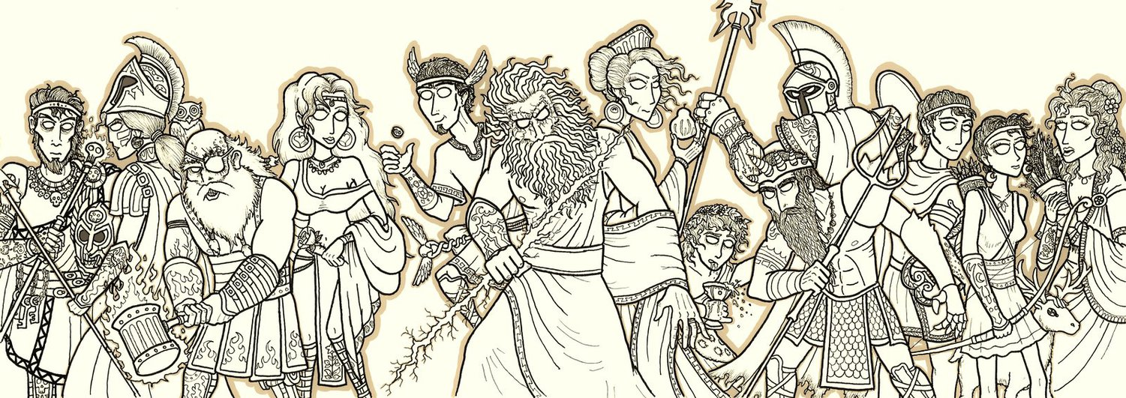
The Olympian Gods & Goddesses
Percy Jackson & The Lightning Thief

Slide 2
Zeus
PARENT: Kronos
SPHERE OF CONTROL:
Lord of the Gods & God of Sky and Thunder
FAMOUS FOR: Being a “lady’s man” and fathering many gods & demigods
SYMBOLS: the thunderbolt, an eagle, the bull, and oak

Slide 3
Hera
PARENT: Kronos
SPHERE OF CONTROL: Queen of the Heavens & Goddess of Marriage and Women
FAMOUS FOR: Her vengeance against husband Zeus
SYMBOLS: pomegranate and peacock

Slide 4
Poseidon
PARENT: Kronos
SPHERE OF CONTROL: King of Atlantis & God of the Sea, Earthquakes, Hurricanes and Horses
FAMOUS FOR: Connection to ocean
SYMBOLS: trident, horse, and bull

Slide 5
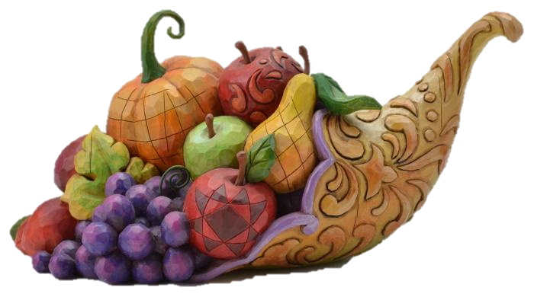
Demeter
PARENT: Kronos
SPHERE OF CONTROL: Goddess of Agriculture, Plants, and the Harvest
FAMOUS FOR: Bringing the four seasons
SYMBOLS: the poppy, grain, and a cornucopia

Slide 6
Hephaestus
PARENT: Hera
SPHERE OF CONTROL:
God of Fire, Masonry, and the Forge
FAMOUS FOR: Being the metal and weapon smith of the gods and being married to Aphrodite
SYMBOLS: fire, volcano, and hammer

Slide 7
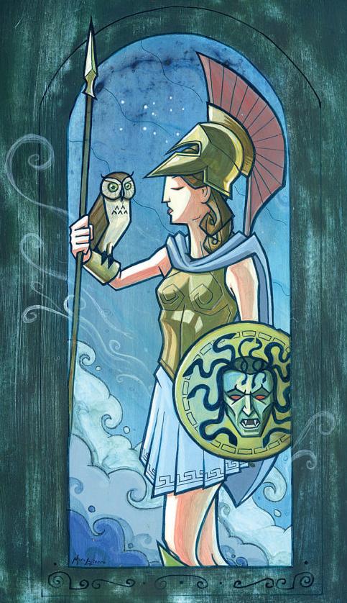
Athena
PARENT: Zeus
SPHERE OF CONTROL: Goddess of Wisdom, Craft, and Battle Strategy
FAMOUS FOR: Being born fully grown in full battle armor from Zeus’ forehead
SYMBOLS: an owl and olive tree

Slide 8
Aphrodite
PARENT: Uranus
SPHERE OF CONTROL: Goddess of Love, Beauty, and Fertility
FAMOUS FOR: Having many lovers
SYMBOLS: dove, rose scallop shell, swan, and dolphin

Slide 9
Ares
PARENT: Zeus
SPHERE OF CONTROL:
God of War, Violence, and Bloodlust
FAMOUS FOR: His affair with Aphrodite and bloodshed
SYMBOLS: boar, raven, vulture, an axe, and spears

Slide 10
Apollo
PARENT: Zeus
SPHERE OF CONTROL:
God of Music, Poetry, the Sun, Truth, and Archery
FAMOUS FOR: Having a twin sister Artemis and prophecies
SYMBOLS: lyre, snakes, bow & arrow

Slide 11
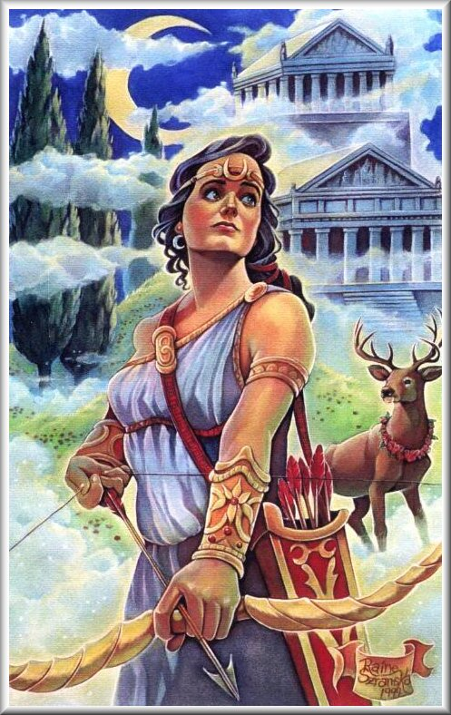
Artemis
PARENT: Zeus
SPHERE OF CONTROL: Goddess of Hunting, Archery, the Moon, and the Wild
FAMOUS FOR: Having a twin brother Apollo and protecting purity
SYMBOLS: bow & arrow, moon, deer

Slide 12
Hermes
PARENT: Zeus
SPHERE OF CONTROL:
God of Communication, Thieves, Travelers, Doctors, and Athletes
FAMOUS FOR: Being the guide to the Underworld
SYMBOLS: tortoise, lyre, caduceus

Slide 13
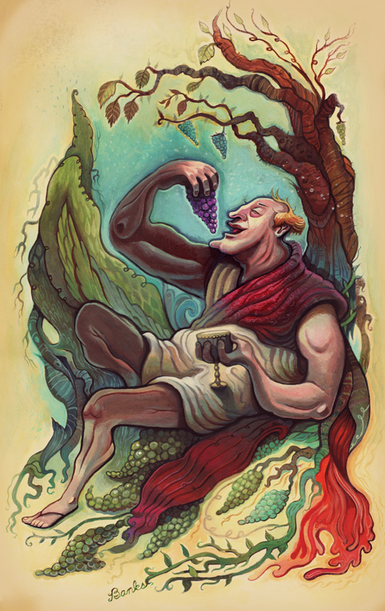
Dionysus
PARENT: Zeus
SPHERE OF CONTROL:
God of Wine, Insanity
Merrymaking, and Fertility
FAMOUS FOR: Being the youngest Olympian and the only demi-god
SYMBOLS: grapevine and jaguar

Slide 14
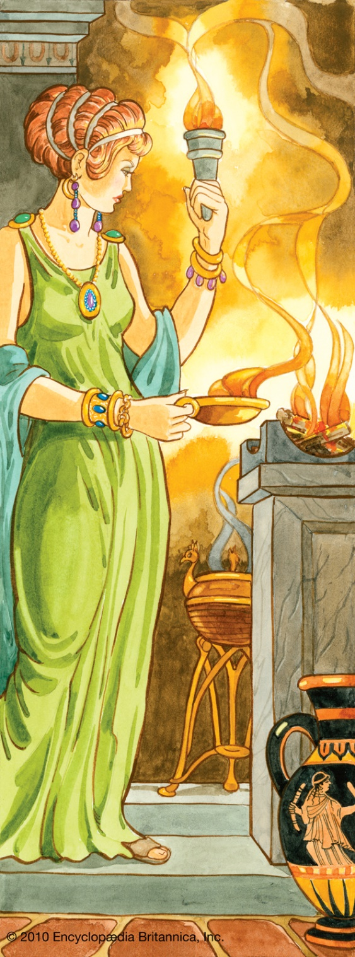
Hestia
PARENT: Kronos
SPHERE OF CONTROL: Goddess of the Home, Hearth, Architecture and Family
FAMOUS FOR: Rejecting marriage proposals
SYMBOLS: fire and hearth

Slide 15
Hades
PARENT: Kronos
SPHERE OF CONTROL:
King of the Underworld, God of the Dead, Wealth and Torture
FAMOUS FOR: Kidnapping Persephone, daughter of Demeter
SYMBOLS: coin, skull, hell hound

